Slide 1

Introduction to electronics
Department of Computer Science and Engineering (CSE)
BRAC University
CSE251 – Electronic Devices and Circuits
UTSAB SAHA, Lecturer
Department of Computer Science and Engineering (CSE)
BRAC University

Slide 2
Lecture 01: Outline
Course Prologue
History of Electronics
Revisit to CSE 250
Circuit Schematics & Representation
Alternative Circuit Representation: Line Diagram
‹#›

Slide 3
Course Prologue
Timelines:
31.01.2026 | Classes of Spring begin
30.03.2026 | MID Term Exam
10.05.2026 | Last class of Spring 26
13.05.2026 | Final Exam
CSE251 – Electronic Devices and Circuits
‹#›

Slide 4
Course Prologue
Distribution of Marks:
Assessment | Percentage | Total number of assessments | Number of assessment to be graded
Attendance | 5% | - | -
Assignment | 5% | 3/4 | [if n>3; Best (n-1)]
Quiz | 15% | 4 | Best 3 [Best (n-1)]
Midterm | 25% | 1 | 1
Final | 25% | 1 | 1
Lab | 25% | - | -
CSE251 – Electronic Devices and Circuits
‹#›

Slide 5
Course Prologue
Things to remember:
    Quiz questions should help prepare the students for the midterm and final exams.
    Questions for quiz, midterm, and final are often modified versions of assignments
    You can collab, but you cannot copy. Plagiarism will result in null marks.
CSE251 – Electronic Devices and Circuits
‹#›

Slide 6
Course Prologue
Absence/Late Policies:
    Attendance will be recorded and shared
    Attendance: P/A/L. You can be ‘Excused’ for ‘A’ if you show Medical documents
    Attendance<70% won’t qualify for Mid/Final
    Assignment deadlines won’t change
    You can be late for a total of 4 days for assignments in the entire semester
DO NOT:
    Copy/Cheat. If so, negative/capped marks/suspension will be the outcome
CSE251 – Electronic Devices and Circuits
‹#›

Slide 7
History of Electronics
Electronics emerged with the discovery of the electron in 1897 and the invention of the vacuum tube, which amplified and rectified electrical signals.
Vacuum tubes [Link] were the first active electronic components and revolutionized various industries, including radio, television, telephony, and music recording.
The point-contact [Link] transistor was invented in 1947, marking a significant technological advancement, although vacuum tubes still dominated until the 1980s.
The IBM 608 [Link] calculator in 1955 became the first commercial product to use transistors exclusively, leading to their widespread use in computer logic and peripherals.
The MOSFET [Link], invented in 1959, revolutionized the electronics industry with its compact size, mass production capabilities, low power consumption, and versatility.
The integrated circuit/IC, developed by Jack Kilby and Robert Noyce, solved the problem of circuit size and speed by integrating components onto a single semiconductor block.
This led to advancements in small-scale integration (SSI), medium-scale integration (MSI), and very large-scale integration (VLSI), with billion-transistor processors becoming available in 2008.
CSE251 – Electronic Devices and Circuits
‹#›

Slide 8
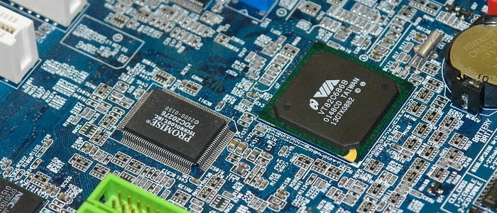
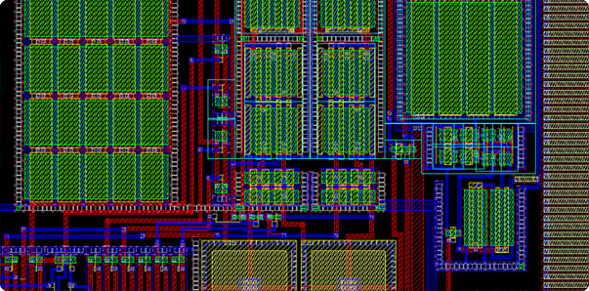
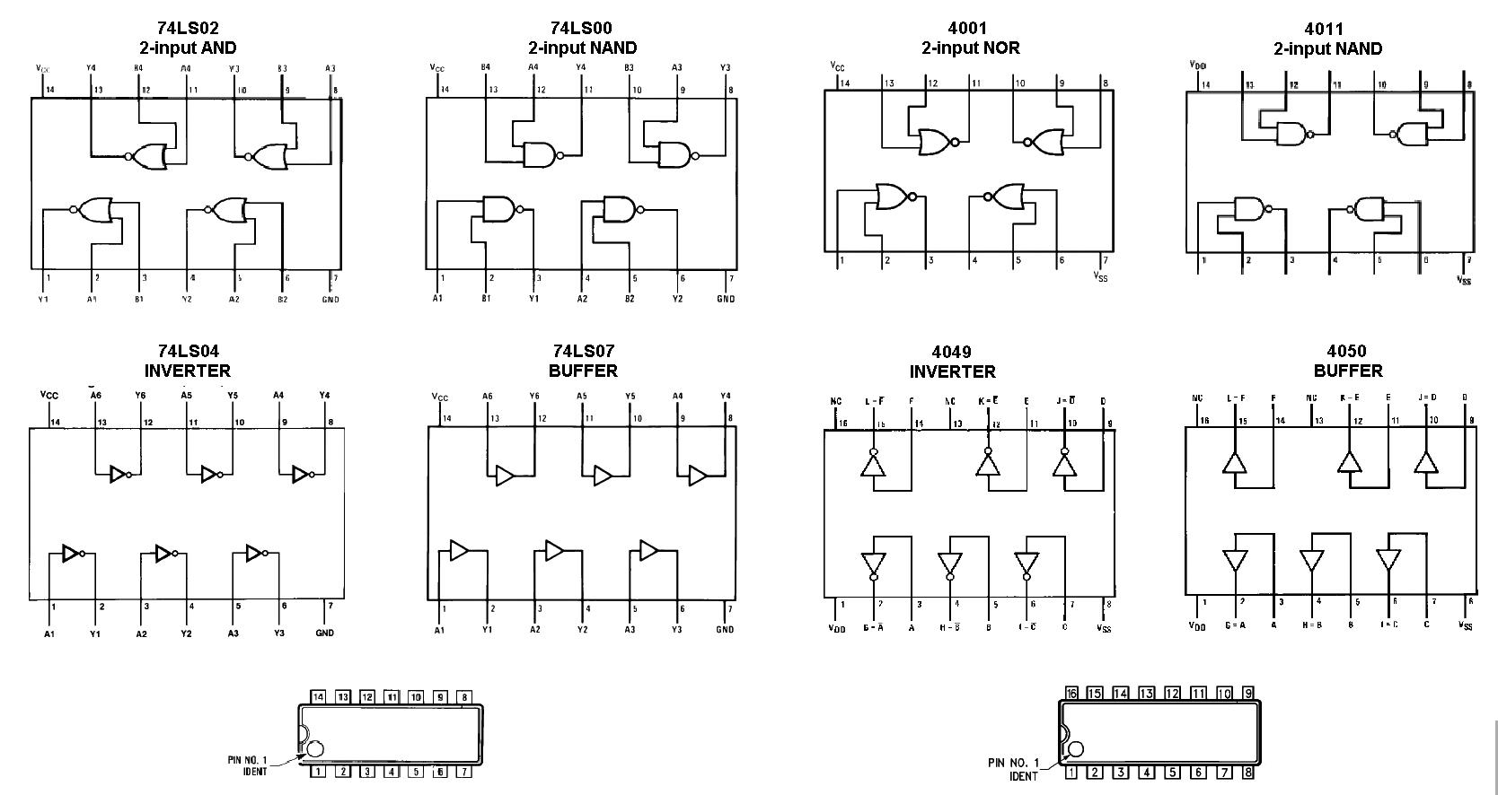
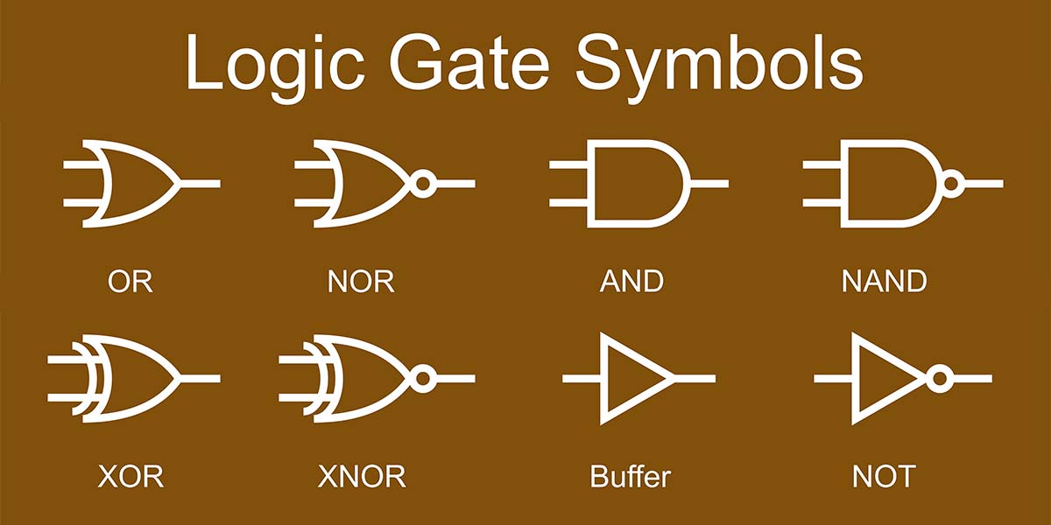
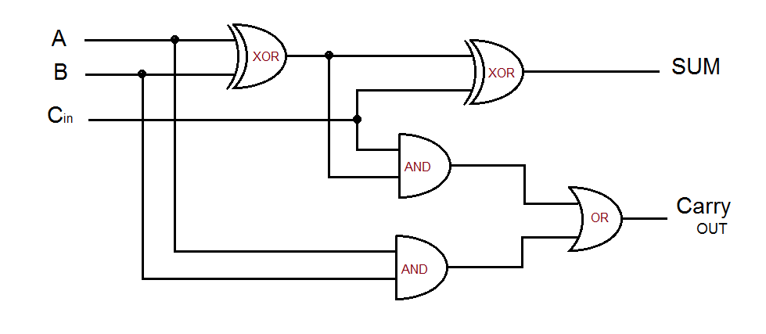
Why do we need Electronics?
Switches/Logics
Arithmetic Operations
IC design
Chip Design
Computers
CSE251 – Electronic Devices and Circuits
‹#›

Slide 9
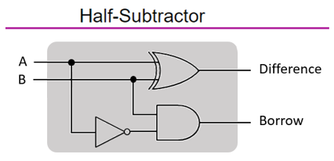
Background
The initial task of the Computer was to ‘Compute’. To be more specific, it made mathematical operations automatic.
CSE251 – Electronic Devices and Circuits
‹#›

Slide 10
Background
We know computer only understand binary bits (‘0’ and ‘1’). Let’s think about a few basic mathematical operations.
Addition: We can do this operation using Half/Full adder
Subtraction: Add with 2’s Compliment
Multiplication: Multiple time addition
Division: Multiple-time subtraction
Addition: 4 + 5 = 9 (0100 + 0101 = 1001)
Subtraction: 10 – 9 = 1 (1010 + 0111 = 0001)
Multiplication: 5x4 = 4+4+4+4+4 = 20
Division: 10/2 = 2 can be subtracted from 10, 5 times
CSE251 – Electronic Devices and Circuits
‹#›

Slide 11
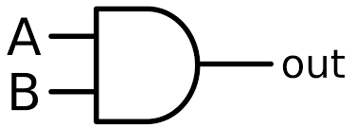
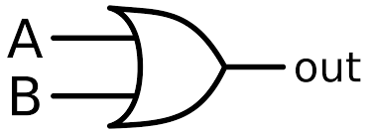
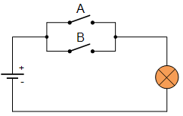
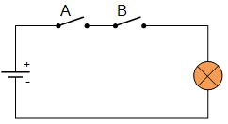
Background
In practice while implementing any logic function we need to know about Switching. Using different types of switches we can easily implement any logic function
AND Gate
OR Gate
The faster you can operate these switches, the faster you can complete the functions!!!
CSE251 – Electronic Devices and Circuits
‹#›

Slide 12
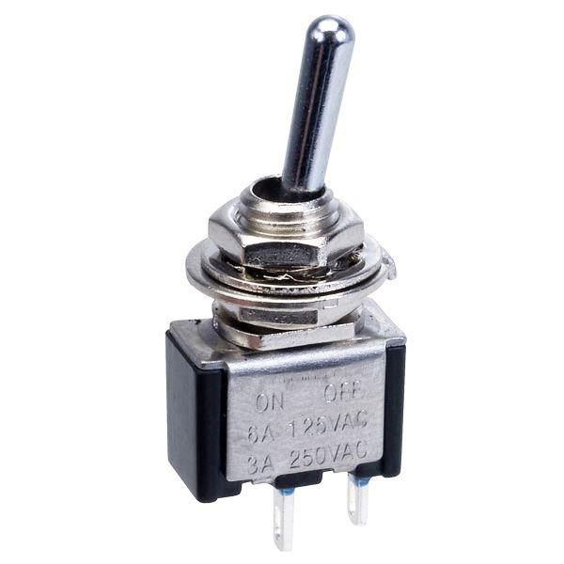
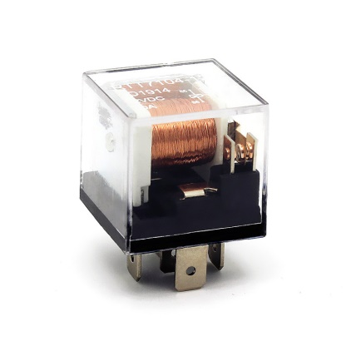
Background
The speed of computational operations depends on the ‘Speed of Switching’
Normal Mechanical Switch: Not Reliable
Causes: Bulky and heavy,
Mechanical wear over time,
Noisy, ultra-slow
Requires lots of energy to operate
Electronics: Help to increase the switching speed
SPST Switch
Electromechanical Relay
CSE251 – Electronic Devices and Circuits
‹#›

Slide 13
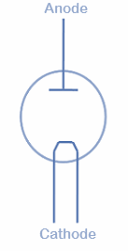
First Electronic Switch
The first electronic switch, the vacuum tube (or thermionic valve), was invented by John Ambrose Fleming in 1904.
(-) ve terminal : Cathode
(+) ve terminal : Anode
Cathode was heated at high temperature, that emits electrons (thermionic emission) which travel to the anode, allowing current to flow in one direction
CSE251 – Electronic Devices and Circuits
‹#›

Slide 14
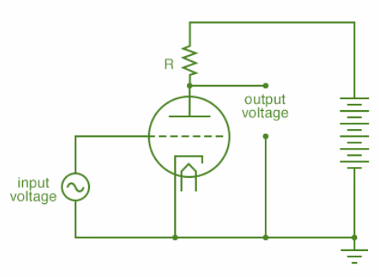
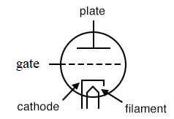
First Electronic Switch
In 1906, Lee De Forest improved the previous configuration by adding a third electrode (grid/gate), which is placed between cathode and anode.
By applying a small voltage to the grid, the flow of electrons can be controlled, allowing the tube to act as a switch.
Disadvantage:
High Voltage Needed
Burn due to High Temperature (Non-reliable)
Bulky
CSE251 – Electronic Devices and Circuits
‹#›

Slide 15
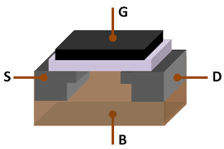
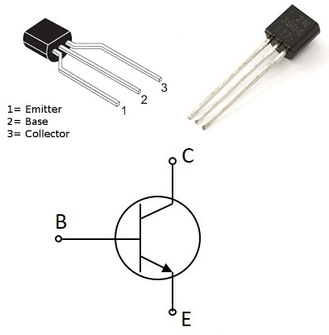
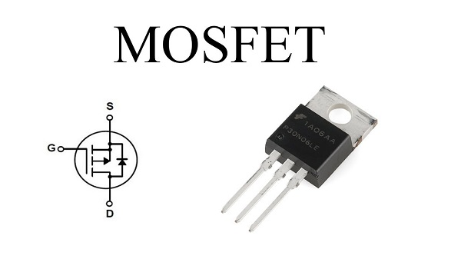
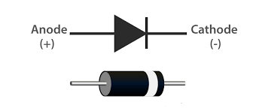
Recent Electronic Switch
  No moving parts
  Scalable
  High speed
5GHz computer 🡪 5 billion operations per second !!!
Any circuit consisting of semiconductors can be considered as electronic SW.
Diode
BJT
MOSFET
CSE251 – Electronic Devices and Circuits
‹#›

Slide 16
CSE 251: Where does it fit in?
High level programming language ( C++, Java, Python etc.)
Computer
Architecture and Microprocessor
courses
Assembly language (x86 assembly language, ARM, CUDA)
Machine Language
Architecture (RISC, CISC, IBM Power; Instruction sets varies depending on the architecture)
DLD Course
System level (Register, MUX, Encoder, Decoder)
CSE251 – Electronic Devices and Circuits
‹#›

Slide 17
CSE 251: Where does it fit in?
Gate level (AND, OR, NOT) + Logic level + Logic Family
CSE 350 + CSE 460
Transistors/ Switch (Digital Electronics)
CSE 251
CSE251 – Electronic Devices and Circuits
‹#›

Slide 18
CSE 251: Where does it fit in?
Digital Electronics
  Boolean logic
  Addition, subtraction, multiplication, division
Analog Electronics
  Amplifiers, radio transmitter and receivers, modulator
Power Electronics
  Motor control
  AC to DC conversion or vice versa
  HVDC circuits
  Charge control circuits
CSE251 – Electronic Devices and Circuits
‹#›

Slide 19
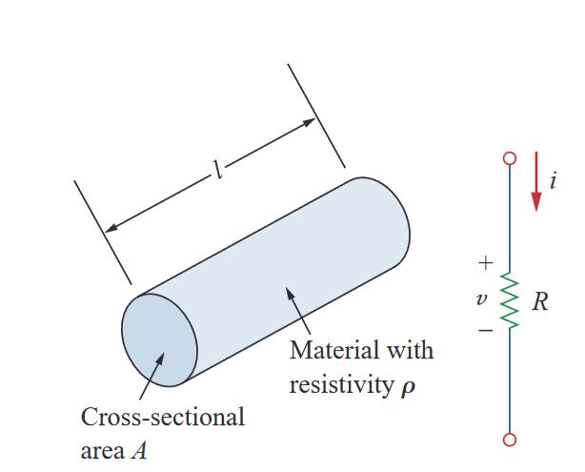
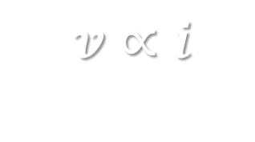
Revisit to CSE 250: Ohm’s Law
The Fundamental Ohm’s Law: The voltage across a resistor v is directly proportional to the current i flowing through the resistor.
CSE251 – Electronic Devices and Circuits
‹#›

Slide 20
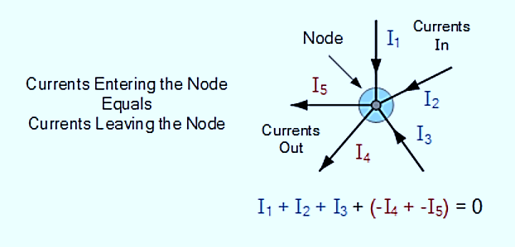
Revisit to CSE 250: KCL
KCL: “Total current entering a junction or node is exactly equal to the charge leaving the node as it has no other place to go except to leave, as no charge is lost within the node”
CSE251 – Electronic Devices and Circuits
‹#›

Slide 21
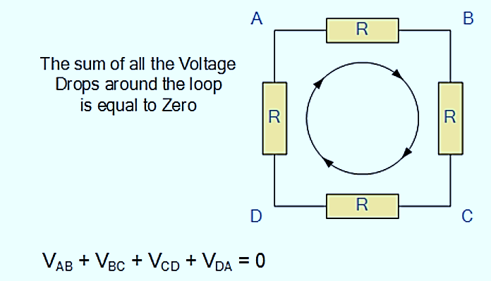
Revisit to CSE 250: KVL
KVL: “In any closed loop network, the total voltage around the loop is equal to the sum of all the voltage drops within the same loop”
CSE251 – Electronic Devices and Circuits
‹#›

Slide 22

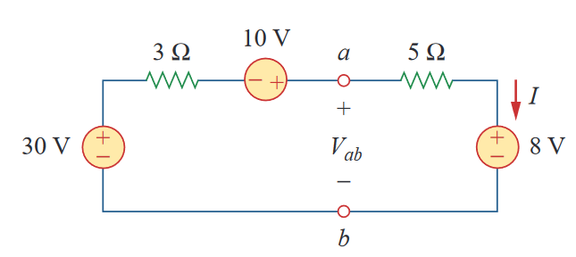
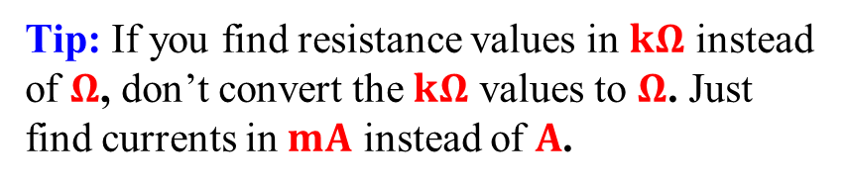
Revisit to CSE 250: KVL – Example 1
CSE251 – Electronic Devices and Circuits
‹#›

Slide 23

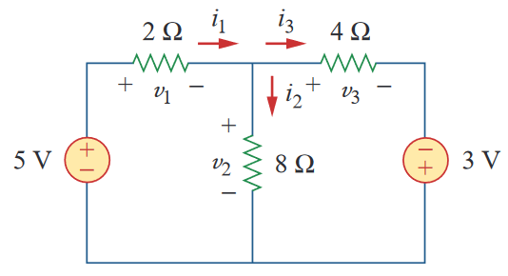
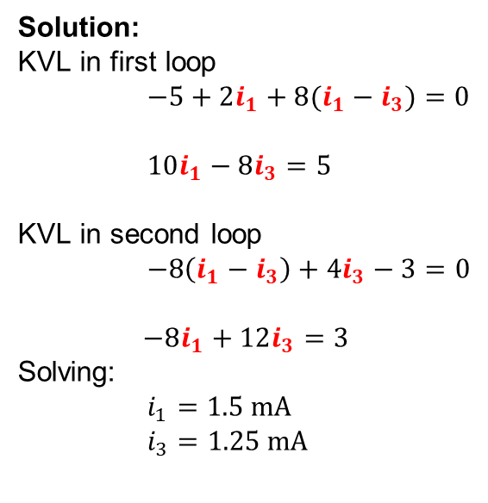

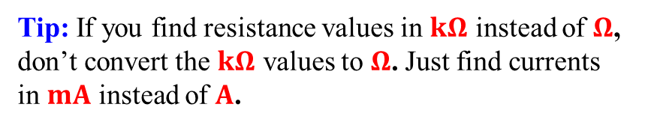
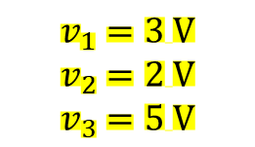
Revisit to CSE 250: KVL – Example 2
CSE251 – Electronic Devices and Circuits
‹#›

Slide 24
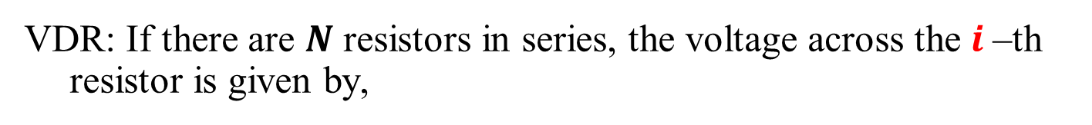
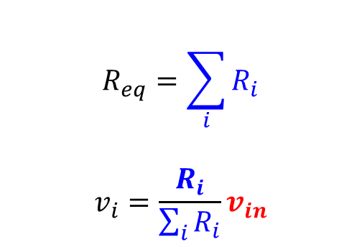
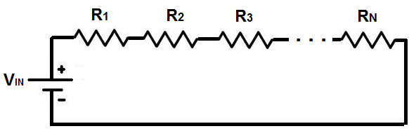
Revisit to CSE 250: Series Resistors and Voltage Division
CSE251 – Electronic Devices and Circuits
‹#›

Slide 25
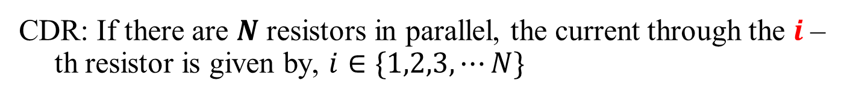
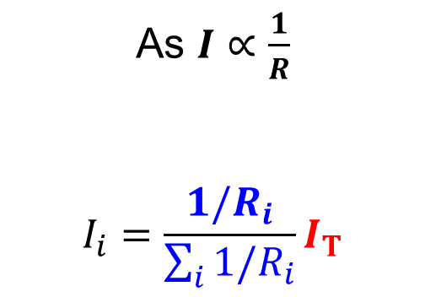
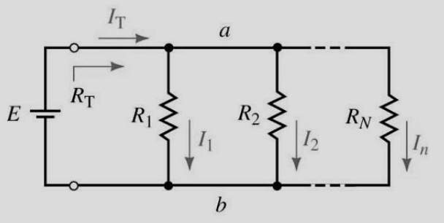
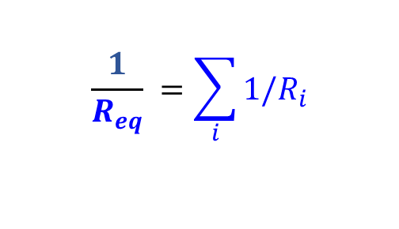
Revisit to CSE 250: Series Resistors and Voltage Division
CSE251 – Electronic Devices and Circuits
‹#›

Slide 26
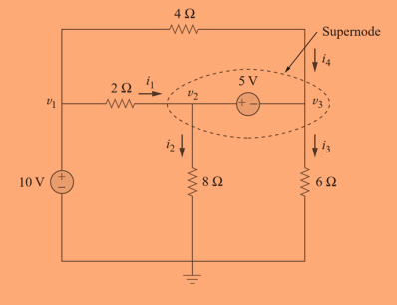
Revisit to CSE 250: Nodal Analysis
Write down the node equations for the given circuit.
CSE251 – Electronic Devices and Circuits
‹#›

Slide 27






Alternative Circuit Representation: Line diagrams
Goal: Representing circuits using Shorthand notations
Steps
Identify the ‘Nodes’
Select one node as ‘Ground’
Replace the other known voltage nodes with an arrow
Vs
R1
R1
R1
I
R1
Vs
I
R2
Vs
I
Vs
I
R2
R2
R2
CSE251 – Electronic Devices and Circuits
‹#›

Slide 28
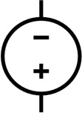
Line diagrams: Example 1
Question: Find the line diagram of the given circuit with voltage sources of opposite polarities.
I₁
I₃
R1
R3
5V
I₂
R2
10V
CSE251 – Electronic Devices and Circuits
‹#›

Slide 29
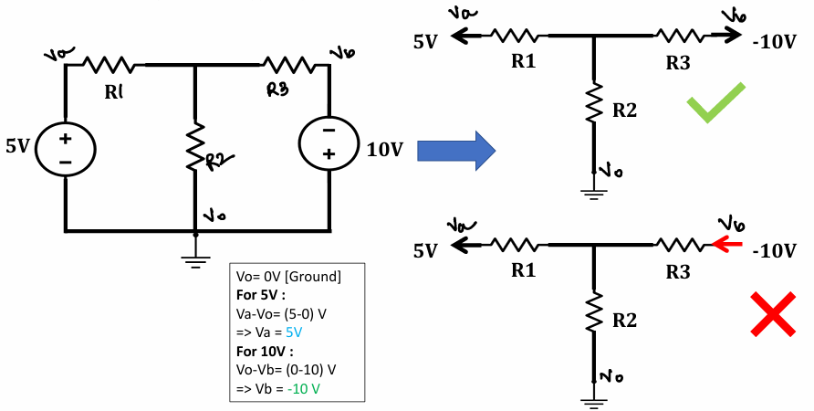
Line diagrams: Example 1 (Solution)
CSE251 – Electronic Devices and Circuits
‹#›

Slide 30
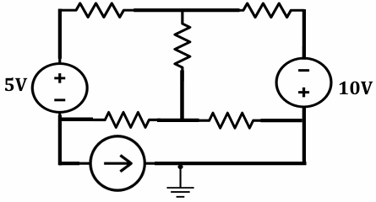
Line diagrams: Example 2
What if the circuit contains a current source/ floating voltage source!!!!
Solution: Keep them as they are!
Question: Find the line diagram of the given circuit.
1A
CSE251 – Electronic Devices and Circuits
‹#›

Slide 31
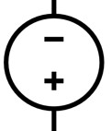
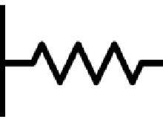


Line diagrams: Example 2 (Solution)
5V
10V
Floating voltage sources: None of the terminals of the 10 V voltage source is connected to the reference i.e. ground node terminals.
1A
CSE251 – Electronic Devices and Circuits
‹#›

Slide 32
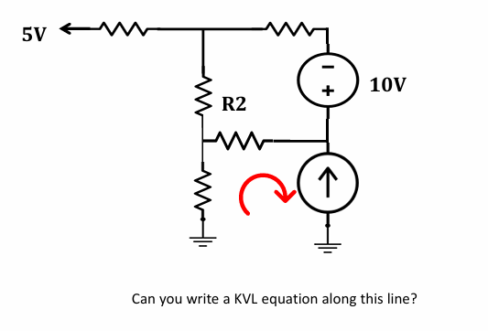
Line diagrams
Can you write a KVL equation along this line?
CSE251 – Electronic Devices and Circuits
‹#›

Slide 33
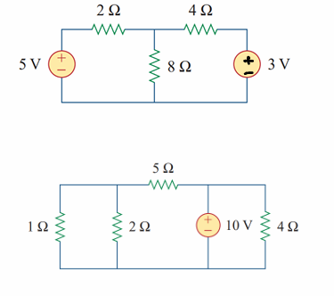
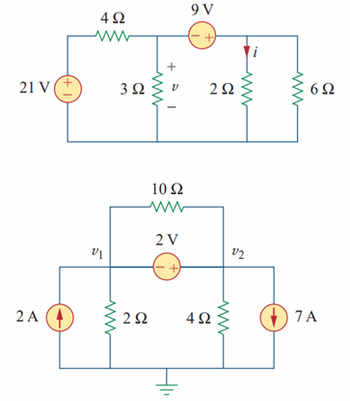
Line diagrams: Practice Problems
Questions: i) Draw Alternative Circuit Diagrams, ii) Write down KCL equations, iii) Write down KVL equations, and iv) Nodal equation
CSE251 – Electronic Devices and Circuits
‹#›

Slide 34
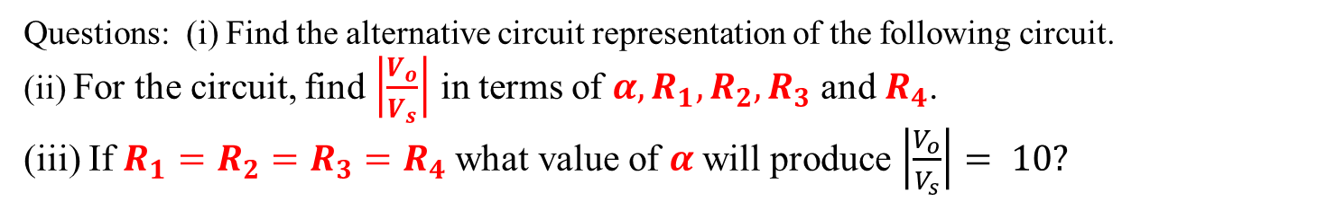
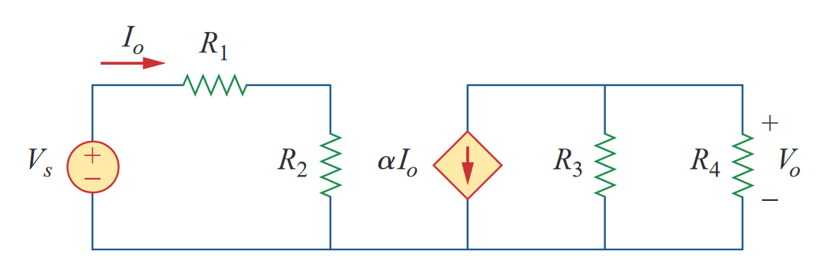
Line diagrams: Example 3
CSE251 – Electronic Devices and Circuits
‹#›

Slide 35
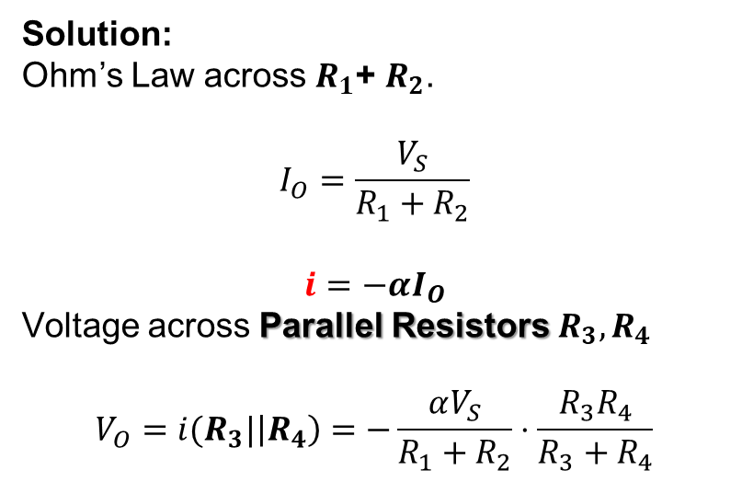

Line diagrams: Example 3 (Solution)
CSE251 – Electronic Devices and Circuits
‹#›

Slide 36
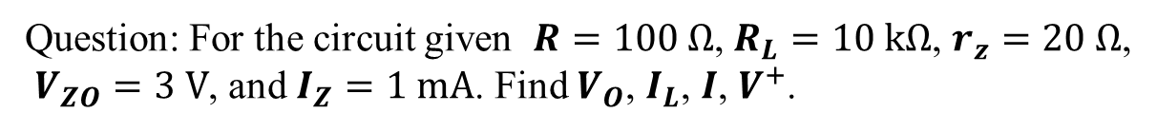
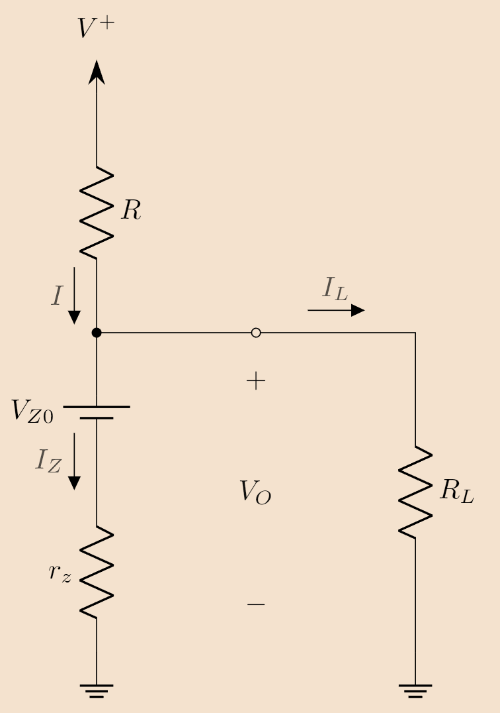
Line diagrams: Practice Problem
I
CSE251 – Electronic Devices and Circuits
‹#›

Slide 37
Line diagrams: Practice Problem
For more problems, please refer to the given link: Test Your Understanding
I
CSE251 – Electronic Devices and Circuits
‹#›

Slide 38
Thank you for your attention
CSE251 – Electronic Devices and Circuits
‹#›

